Slide 1
INFORMATION SYSTEMS
TYPES OF INFORMATION SYSTEMS

Slide 2
TYPES OF INFORMATION SYSTEMS
Types of information systems:
Major types of systems include:
Transaction Processing Systems (TPS)
Management Information Systems (MIS)
Decision Support Systems (DSS)
Executive Support Systems (ESS)
Expert Systems

Slide 3
TYPES OF INFORMATION SYSTEMS
Transaction Processing System (TPS)
A transaction is any business related exchange, such as a sale to a client or a payment to a vendor.
Transaction processing systems process and record transactions as well as update records.
They automate the handling of data about business activities and transactions.
They record daily routine transactions such as sales orders from customers, or bank deposits and withdrawals.
Although they are the oldest type of business information system around and handle routine tasks, they are critical to business organization.

Slide 4
TYPES OF INFORMATION SYSTEMS
TPS cont’d
TPS are vital for the organization, as they gather all the input necessary for other types of systems.
It could be difficult to generate a monthly sales report for middle management or critical marketing information to senior managers without TPS.
TPS provide the basic input to the company’s database. A failure in TPS often means disaster for the organization.
Imagine what happens when an airline reservation system fails: all operations stops and no transaction can be carried out until the system is up and running again.
There would be long queues form in front of ATMs and tellers when a bank’s TPS crashes.

Slide 5
TYPES OF INFORMATION SYSTEMS
Transaction processing systems were created to maintain records and do simple calculations faster, more accurately and more cheaply than people could do the tasks.
Examples—Airline reservation systems, Automated Teller Machines (ATMs,) order processing systems, registration systems, Payroll systems and point of sale systems.

Slide 6
TYPES OF INFORMATION SYSTEMS
MANAGEMENT INFORMATION SYSTEM (MIS)
Management Information System is a system for processing data in order to give proper information to the management for decision making.
Management information system is a system that collects raw data and analyzes it for useful decision making by management.
MIS provides managers with information and support for effective decision making and feedback.
MIS is organized along functional lines within an organization. MIS provides information to the users in the form of reports, which are usually generated through accumulation of transaction processing data.

Slide 7
TYPES OF INFORMATION SYSTEMS
Management Reporting Systems (MRS) formerly called Management information systems (MIS) provide routine information to decision makers.
They are used to make structured, recurring and routine decisions, such as restocking decisions or bonus awards.
They focus on operational efficiency and provide summaries of data.
A MRS takes the relatively raw data available through a TPS and converts it into meaningful aggregated form that managers need in order to conduct their responsibilities.

Slide 8
TYPES OF INFORMATION SYSTEMS
MRS cont’d
MRS generate information for monitoring performance (e.g. productivity information) and maintaining coordination (e.g. between purchasing and accounts payable).
The main input to an MRS is data collected and stored by transaction processing systems.
A MRS further processes transaction data to produce information useful for specific purposes.
Generally, all MIS output have been pre-programmed by information systems personnel.

Slide 9
TYPES OF INFORMATION SYSTEMS
MRS cont’d
Outputs from MRS include :
Scheduled Reports
These were originally the only reports provided by early management information systems.
Scheduled reports are produced periodically, such as hourly, daily, weekly or monthly.
An example might be a weekly sales report that a store manager gets each Monday showing total weekly sales for each department compared to sales this week last year or planned sales.
2. Demand Reports
These provide specific information upon request.
For instance, if the store manager wanted to know how weekly sales were progressing on Friday, and not wait until the scheduled report on Monday, she could request the same report using figures for the part of the week already elapsed.

Slide 10
TYPES OF INFORMATION SYSTEMS
Outputs cont’d
3. Exception Reports
These are produced to describe unusual circumstances. For example, the store manager might receive a report for the week if any department’s sales were more than 10% below planned sales.

Slide 11
TYPES OF INFORMATION SYSTEMS
Decision Support System (DSS)
Decision support systems provide problem-specific support for non-routine, dynamic and often complex decisions or problems.
DSS users interact directly with the information systems, helping to model the problem interactively.
DSS basically provide support for non-routine decisions or problems and an interactive environment in which decision makers can quickly manipulate data and models of business operations.
A DSS might be used to help a management team decide where to locate a new distribution facility. This is a non-routine, dynamic problem.

Slide 12
TYPES OF INFORMATION SYSTEMS
DSS cont’d
Each time a new facility has to be built, the competitive, environmental, or internal contexts are most likely different.
New competitors or government regulations may need to be considered, or the facility may be needed due to a new product line or business venture.
When the structure of a problem or decision changes, or the information required to address it is different each time the decision is made, then the needed information cannot be supplied by an MIS, but must be interactively modelled using a DSS.
DSS provide support for analytical work in semi-structured or unstructured situations.

Slide 13
TYPES OF INFORMATION SYSTEMS
DSS enable mangers to answer ‘What if’ questions by providing powerful modelling tools (with simulation and optimization capabilities) and to evaluate alternatives e.g. evaluating alternative marketing plans.
DSS have less structure and predictable use.
They are user-friendly and highly interactive.
Although DSS use data from the TPS and MIS, they also allow the inclusion of new data, often from external sources such as current share prices or prices of competitors.

Slide 14
TYPES OF INFORMATION SYSTEMS
Executive information system (EIS) / Executive Support Systems (ESS)
EIS provide a generalized computing and communication environment to senior managers to support strategic decisions.
They draw data from the MIS and allow communication with external sources of information.
Unlike DSS, the EIS are not designed to use analytical models for specific problem solving.
EIS are designed to facilitate senior managers’ access to information quickly and effectively.

Slide 15
TYPES OF INFORMATION SYSTEMS
ESS has menu-driven user-friendly interfaces, interactive graphics to help visualization of the situation.
It also has communication capabilities that link the senior executives to the external databases they require.
Top executives need ESS because they are busy and need information quickly and in an easy to read form.
Senior executives want to have direct access to information and want their computer set-up to directly communicate with others.
They want structured forms for viewing and want summaries rather than details.

Slide 16
TYPES OF INFORMATION SYSTEMS
Expert System (ES)
It is an advanced DSS that provides expert advice by asking users a sequence of questions dependent on prior answers that lead to a conclusion or recommendation.
It is made of a knowledge base (database of decision rules and outcomes), inference engine (search algorithm), and a user interface.
ES use artificial intelligence technology.
It attempts to codify and manipulate knowledge rather than information
ES may expand the capabilities of a DSS in support of the initial phase of the decision making process.
It can assist the design phase of the decision making process by suggesting alternative scenarios for "what if" evaluation.

Slide 17
TYPES OF INFORMATION SYSTEMS
An ES assists a human in the selection of an appropriate model for the decision problem.
ES can simplify model-building. Simulation modeling lends itself to this approach.
ES can provide an explanation of the result obtained with a DSS. This would be a new and important DSS capability.
ES capabilities may be employed during DSS development;
ES general potential in software engineering has been recognized.

Slide 18
TYPES OF INFORMATION SYSTEMS
Other Information Systems
These are special purpose information systems. They are more recent types of information systems that cannot be characterized as one of the types discussed above.
Office Automation Systems (OAS)
Office automation systems support general office work for handling and managing documents and facilitating communication.
Text and image processing systems evolved as from word processors to desktop publishing, enabling the creation of professional documents with graphics and special layout features.
Spreadsheets, presentation packages like PowerPoint, personal database systems and note-taking systems (appointment book, notepad, card file) are part of OAS.
In addition OAS include communication systems for transmitting messages and documents (e-mail) and teleconferencing capabilities.

Slide 19
TYPES OF INFORMATION SYSTEMS
Artificial Intelligence Systems
Artificial intelligence is a broad field of research that focuses on developing computer systems that simulate human behaviour, that is, systems with human characteristics.
These characteristics include, vision, reasoning, learning and natural language processing.
Examples: Expert systems, Neural Networks, Robotics.

Slide 20
TYPES OF INFORMATION SYSTEMS
Knowledge Work Systems (KWS)
Knowledge Work Systems support highly skilled knowledge workers in the creation and integration of new knowledge in the company.
An example of KWS is Computer Aided Design (CAD) systems.
These can be used by product designers not only allow them to easily make modifications without having to redraw the entire object, but also enable them to test the product without having to build physical prototypes.
Architects use CAD software to create, modify, evaluate and test their designs; such systems can generate photo-realistic pictures, simulating the lighting in rooms at different times of the day, perform calculations, for instance on the amount of paint required.

Slide 21
TYPES OF INFORMATION SYSTEMS
KWS cont’d
Surgeons use sophisticated CAD systems to design operations.
Financial institutions use knowledge work systems to support trading and portfolio management with powerful high-end PCs.
These allow managers to get instantaneous analysed results on huge amounts of financial data and provide access to external databases.

Slide 22
INFORMATION CONCEPTS
INFORMATION
Information is data that has been organized. Information is data given context, and endowed with meaning and significance.
Information is a value-added data. “A set of classified and interpreted data used in the decision making process".
Information is important at every level in the organization for decision making, planning, organizing, implementing, and monitoring and controlling. Information is valuable because of its content, form and timing of presentation.
Information is the basis for every decision taken in an organization. The efficiency of management depends upon the availability of regular and relevant information.

Slide 23
INFORMATION CONCEPTS
A good system must be able to produce information that carries the following characteristics:
Relevant – information must pertain to the problem at hand.
Complete – partial information is often worst than no information.
Accurate – erroneous information may lead to disastrous decisions.
Current – decisions are often based upon the latest information available.
Economical – in a business setting, the cost of obtaining information must be considered as one cost element involved in any decision.

Slide 24
INFORMATION CONCEPTS
Timeliness: Information must reach the user in a timely manner, just when it is needed; not too early, because by the time it is used it would be out-of-date; not too late because the user will not be able to incorporate it into his/her decision-making.
Appropriateness: Information must be relevant to the person who is using it. It must be within the sphere of his/her activities so that it can be used to reduce uncertainty in his/her decision-making.
Conciseness: Information should always contain the minimum amount of detail that’s appropriate for the user. Too much detail causes Information overload.

Slide 25
INFORMATION CONCEPTS
Information concepts
Data, Information, Knowledge, Wisdom
Data are raw facts such as employee number, hours worked in a week, inventory part numbers, or sales orders.
Information is a collection of facts organized and processed so that they have additional value beyond the value of individual facts.
Knowledge is the awareness and understanding of a set of information and ways that information can be made useful to support a specific task or reach a decision.
Wisdom is the ability to make a good judgment based on what you have learned, from experience, or the knowledge and understanding that gives you this ability

Slide 26
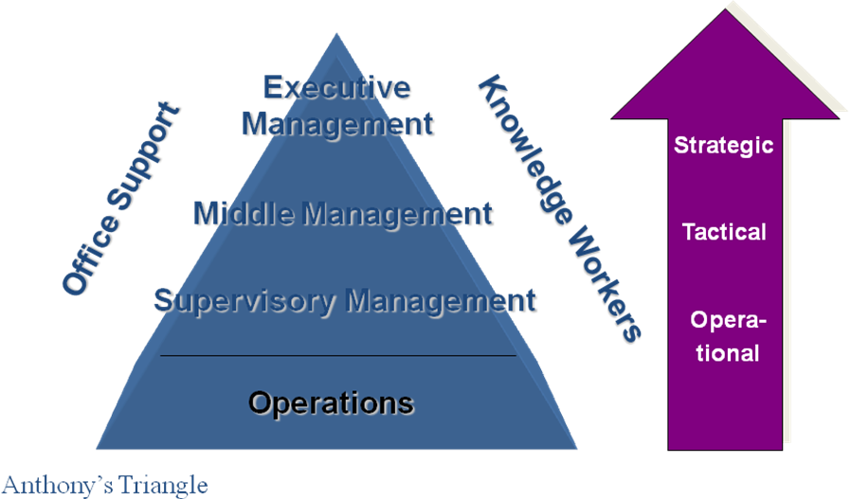
INFORMATION CONCEPTS
Where is information needed?

Slide 27
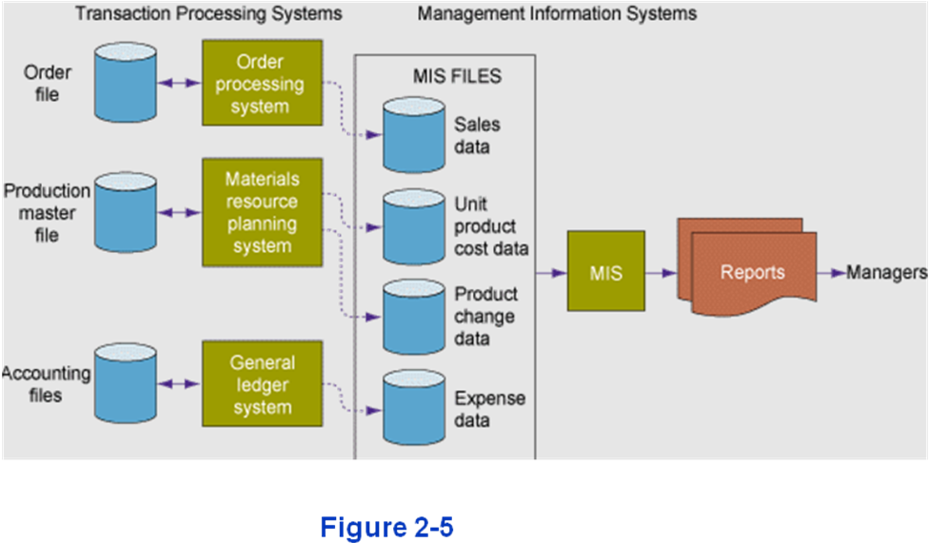
RELATION BETWEEN TPS AND MIS
Relation between TPS and MIS

Slide 28
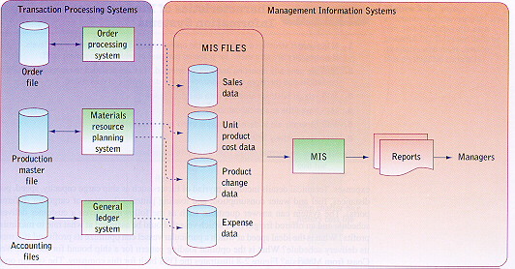
RELATION BETWEEN TPS AND MIS
TPS and MIS

Slide 29
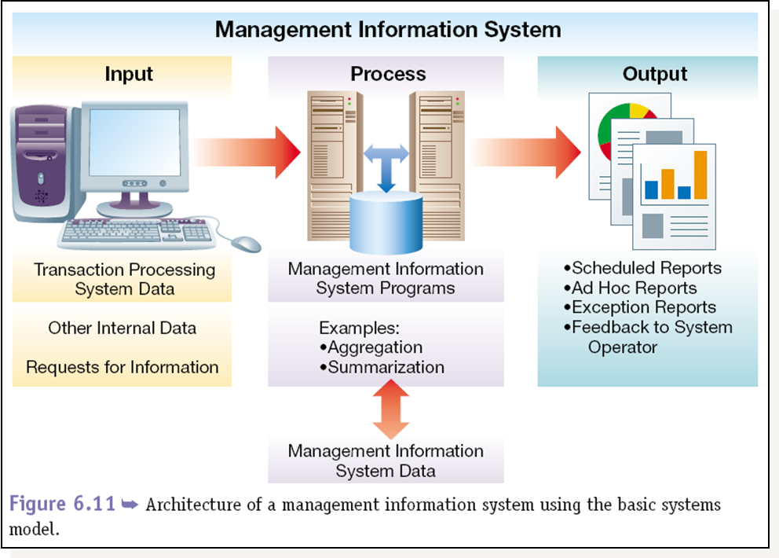
RELATION BETWEEN TPS AND MIS
MIS System Architecture:

Slide 30
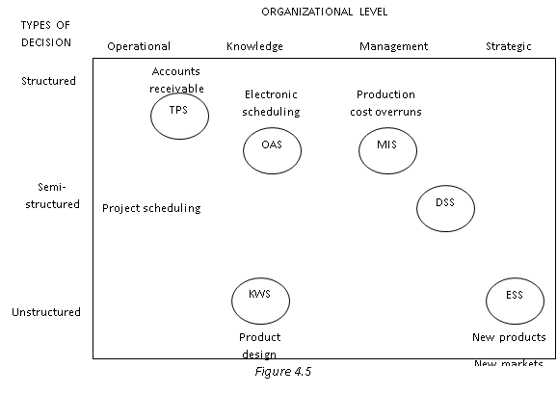
RELATIONSHIP BETWEEN DIFFERENT INFORMATION SYSTEMS

Slide 31
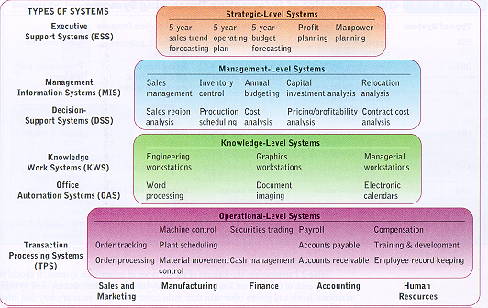
RELATIONSHIP BETWEEN DIFFERENT INFORMATION SYSTEMS

Slide 32
Information resource management
Information resource management has become a popular way to emphasize a major change in the management and mission of the information systems function in many organizations.
In many organizations, IRM may be viewed as having five major dimensions
Strategic Management
Operational Management
Resource Management
Technology Management
Distributed Management

Slide 33
Information resource management
Strategic Management
The IS function must manage information technology so that it makes major contributions to the profitability and strategic objectives of the firm.
The information systems’ function must change from an information services utility focussed only on serving a firm’s transaction processing or decision support needs.
Instead it must become a producer or packager of information products or an enabler of organizational structures and business processes.
The functionality above can give a firm a comparative advantage over its competitors.

Slide 34
Information resource management
Strategic Management cont’d
The Chief Information Officer:
Many companies have created a senior management position, the chief information officer (CIO), to oversee the use of IT. The CIO has three main responsibilities:
1.Oversee the support services of traditional computer services, telecommunications, office automation systems, and other IS technology support services.
2.Concentrates on long-term planning and strategy. CIO does not direct day-to-day information service activities.
3.Works with other top executives to develop strategic information systems that help make the firm more competitive in the marketplace.

Slide 35
Information resource management
2. Operational Management
The IRM concept stresses that information technology and information systems can be managed by functional organizational structures and managerial techniques commonly used throughout other business units.
Information services departments perform several basic functions and activities. These can be grouped into three basic IS functions: i.e.
Systems development, operations and Technical services
Systems development management means managing activities such as systems analysis and design, prototyping, applications programming, project management, quality assurance, and system maintenance for all major business/IT development projects.

Slide 36
Information resource management
Operational management cont’d
Operations
IS operations management is concerned with the use of hardware, software, network, and personnel resources in the corporate or business unit data centres (computer centres) of an organization.
Operational activities that must be managed include data entry, equipment operations, production control, and production support.
Technical services
Computing and telecommunication services for interconnection of stake-holders
Data management services
Application software services e.g. Enterprise systems
Education, research and development services

Slide 37
Information resource management
Operational Management cont’d
Centralization versus Decentralization:
Modern computer-based information systems can support either the centralization or decentralization of information systems operations and decision-making within computer-using organizations.
Centralized computer facilities:
Can connect all parts of an organization by telecommunications networks to allow top management to centralize decision making formerly done by lower levels of management.
Can promote centralization of operations, which reduces the number of branch offices, manufacturing plants, warehouses, and other work sites needed by the firm.

Slide 38
Information resource management
Decentralized computer facilities:
Distributed networks of computers at multiple work sites can allow top management to delegate more decision making to middle managers.
Management can decentralize operations by increasing the number of branch offices while still having access to the information and communications capabilities they need to control the overall direction of the organization.
Information technology can encourage either the centralization or decentralization of information systems, business operations, and management.

Slide 39
Information resource management
3. Resource Management
Data and information, hardware and software, telecommunications networks, and IS personnel are valuable resources that should be managed for the benefit of the entire organization.
Human Resource Management
The success or failure of an information services organization rests heavily on the quality of its people.
Managing information services functions involves the management of managerial, technical, and clerical personnel.
One of the most important jobs of information service managers is to recruit qualified personnel and to develop, organize, and direct the capabilities of existing personnel.

Slide 40
Information resource management
Roles of HRM
Employees must be continually trained to keep up with the latest developments in a fast-moving and highly technical field.
Employee job performance must be continually evaluated and outstanding performances rewarded with salary increases or promotions.
Salary and wage levels must be set, and career paths must be designed so individuals can move to new jobs through promotion and transfer as they gain in seniority and expertise.

Slide 41
Information resource management
4. Technology Management
All technologies that process, store, and deliver data and information throughout the enterprise must be managed as integrated systems of organizational resources.
Such technologies include the Internet, intranets, and electronic commerce and collaboration systems, as well as traditional computer-based information processing.
Network Management
Network management a major technology management function. This function is responsible for managing a company’s Internet access, intranets and extranets, and the wide area networks and interconnected local area networks of client/server computing. These networks require:
The major commitment of hardware and software resources.
The creation of managerial and staff positions to manager their use.

Slide 42
Information resource management
Network management is responsible for overseeing the quality of all the telecommunications services that most businesses rely on today.
Roles of Network managers:
Evaluating and recommending the acquisition of Internet service providers, Internet and intranet servers and web browser suites, and communications hardware and software for workgroup and corporate client/server networks.
Coordinating with business unit manager to improve the design, operational quality, and security of the organization’s telecommunications networks and servers.
Monitoring and evaluating Internet, intranet, and other network usage, telecommunications processors, network control software, and other network hardware and software resources to ensure a proper level of service to the users of a network.

Slide 43
Information resource management
5. Distributed Management
Responsibility for managing information technology is increasingly being distributed to the managers of an organization at all levels and in all functions.
Information resource management is not just the responsibility of an organization's CIO.
IRM is a responsibility for all managers, whether its a manager of a company, a department, a workgroup, or a functional area.

